Slide 1

HEART DISEASE PREDICTION
Mini Project 2B

Slide 2
Project made under the guidance of :
Dr. Shweta Malik
Associate Professor
Department of computer
Engineering
Terna Engineering College

Slide 3
Team members
Sahil Bhosale - A-44 - TU3F1920044
Manoj Landge - A-13 - TU3F1920012
Parag Bhandari - A-36 - TU3F1920036
Abhishek Eitkar - A-14 - TU3F1920013

Slide 4

Index
01
Introduction
Literature Survey
02
03
Problem Statement
Objectives
04
05
Features
Proposed Methodology
06
07
Hardware and Software
Conclusion
08
09
Future Scope
10
References

Slide 5
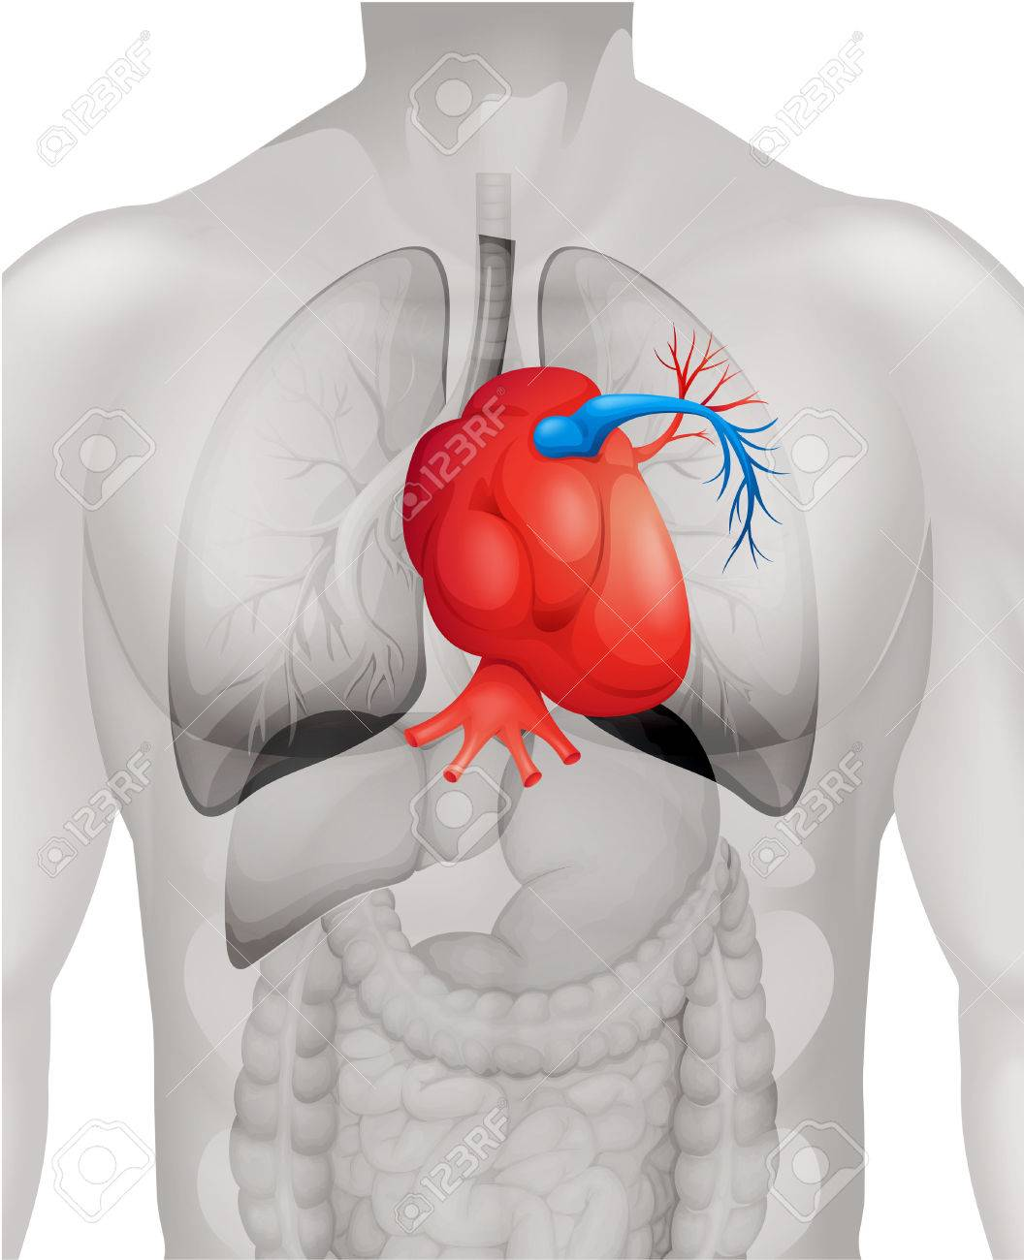
Introduction
Heart plays significant role in living organisms. Diagnosis and prediction of heart related diseases requires more precision, perfection and correctness because a little mistake can cause fatigue problem or death of the person, there are numerous death cases related to heart is increasing exponentially day by day. To deal with the problem there is essential need of prediction system for awareness about diseases. Machine learning is the branch of Artificial Intelligence(AI), it provides prestigious support in predicting any kind of event which take training from natural events.

Slide 6
Literature survey
[1] Gautam Srivastava and et al demonstrated method that aims at finding significant features by The prediction model is introduced with different combinations of features and several known classification techniques.
[2] Vijeta Sharma and others illustrated correlations between the different attributes available in the dataset with the help of standard Machine Learning methods and then using them efficiently in the prediction of chances of Heart disease.
[3] Snehith Raja and et al proposed reliable heart disease prediction system is implemented using strong Machine Learning algorithm which is the Random Forest algorithm.

Slide 7
Problem Statement
Proposed System :
Existing System :
In Existing System , there are very few instruments available which can predict heart disease but either they are expensive or are not efficient to calculate chance of heart disease in human.
It is not possible to monitor patients every day in all cases accurately and consultation of a patient for 24 hours by a doctor is not available since it requires more time and expertise.
In Proposed System acts as a decision support system and will prove to be an aid for the doctors with the diagnosis.
we have a good amount of data in today’s world, we have used one of the dataset from that and using various machine learning algorithms to analyze the data for hidden patterns.
For that we have taken certain biological parameters of heart as our attributes for training

Slide 8


Objectives
To develop ML model to predict future possibility of heart disease
To reduce expensive cost medical tests.
To study various machine kearning algorithms .
To reduce time complexity for making decisions.
To avoid human biasness .
Analysis of results of various ML Algorithms

Slide 9
Features
It uses best accurate target parameters from dataset
for training and testing
01
It gives analysis between machine algorithms
02
Random Forest Algorithm is used which gives highest accuracy
03
04
User friendly GUI provided for user

Slide 10
Proposed methodology
Data set
Attributes Selection
Pre-processing on data
Classification Techniques
Logistic Regression
Decision Tree
Random Forest
Patient
Details
Accuracy Measure
Disease Prediction GUI

Slide 11
Conclusion
The proposed system is GUI-based, user-friendly, scalable, reliable and an expandable system.
The proposed working system can also help in reducing treatment costs by providing Initial diagnostics in time. The model can also serve the purpose of training tool for medical students and will be a soft diagnostic tool available for physician and cardiologist.
We have successfully compared the accuracy of various machine learning algorithms . Random forest algorithm is the best algorithm which gives a great accuracy standard for producing the best estimation result .

Slide 12
Future Scope
General physicians can utilize this tool for initial diagnosis of cardio-patients.There are many possible improvements that could be explored to improve the scalability and accuracy of this prediction system.
Generally, the dimensionality of the heart database is high, so identification and selection of significant attributes for better diagnosis of heart disease are very easy tasks for future research.
As we have developed a generalized system, in future we can use this system for the analysis of different data sets. The performance of the health’s diagnosis can be improved significantly by handling numerous class labels in the prediction process and it can be another positive direction of future research.

Slide 13
References
[1] Gautam Srivastava Effective Heart Disease Prediction Using Hybrid Machine Learning Techniques Volume 7 , 81542 - 81554 June 2019
[2] Vijeta Sharma , Heart Disease Prediction using Machine Learning Techniques. 2nd International Conference on Advances in Computing Dec 2020
[3] M. Anurag Machine Learning Based Heart Disease Prediction System. International Conference on Computer Communication and Informatics (ICCCI) April 2021

